Slide 1
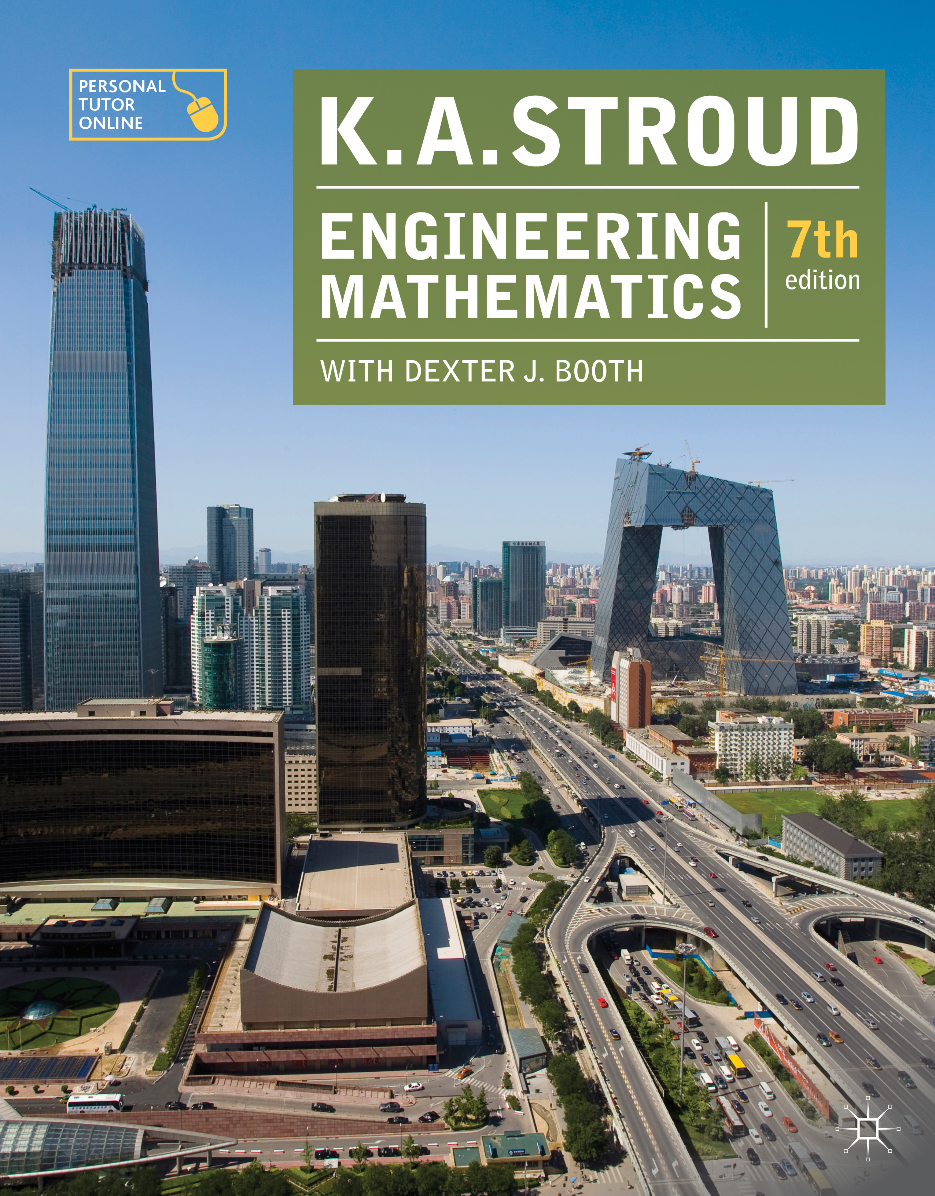
PROGRAMME 7
DIFFERENTIATION

Slide 2
Standard derivatives
Functions of a function
Logarithmic differentiation
Implicit functions
Parametric equations

Slide 3
Standard derivatives
Functions of a function
Logarithmic differentiation
Implicit functions
Parametric equations

Slide 4
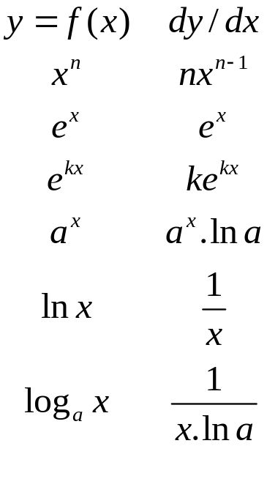
Standard derivatives
As an aide memoir this slide and the following slide contain the list of standard derivatives which should be familiar.

Slide 5
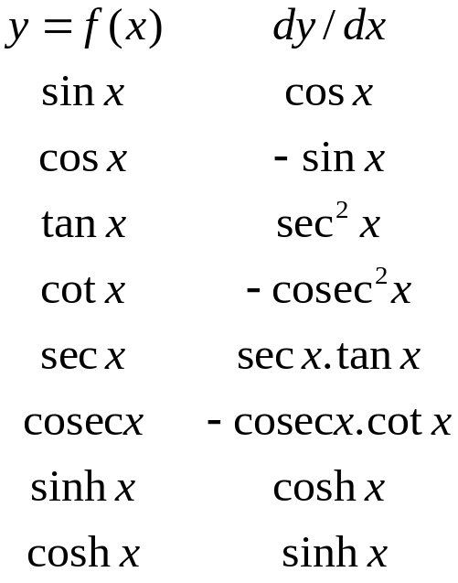
Standard derivatives

Slide 6
Standard derivatives
Functions of a function
Logarithmic differentiation
Implicit functions
Parametric equations

Slide 7
Standard derivatives
Functions of a function
Logarithmic differentiation
Implicit functions
Parametric equations

Slide 8
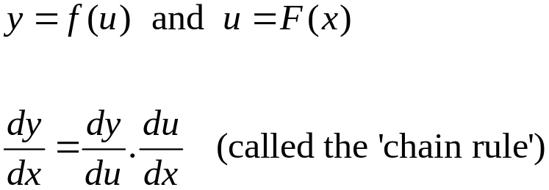
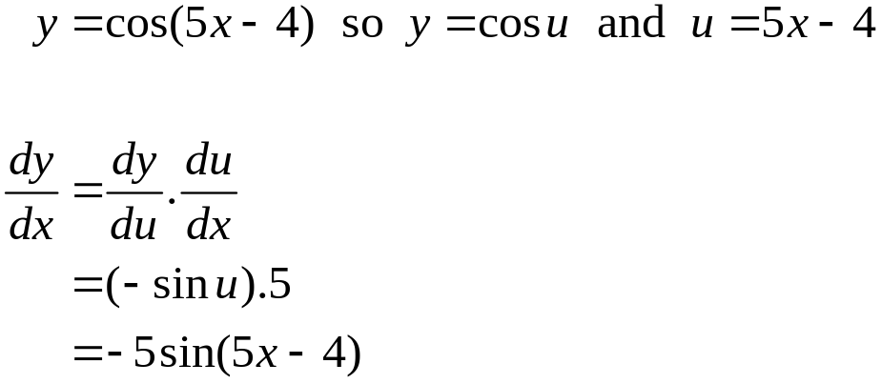
Functions of a function
If:
then
For example:

Slide 9
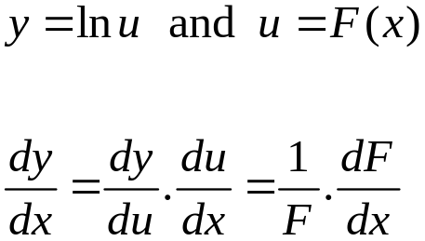
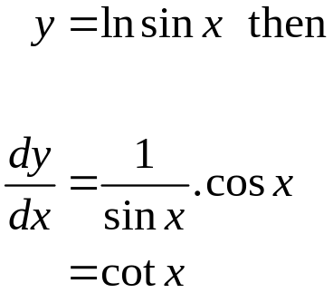
Functions of a function
If:
then
For example:

Slide 10
Functions of a function
Products
Quotients

Slide 11
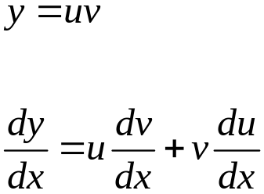
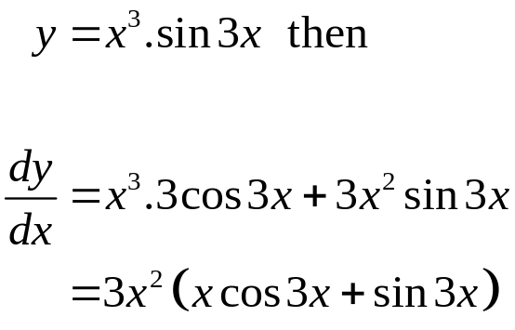
Functions of a function
Products
If:
then
For example:

Slide 12
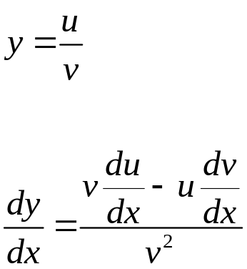
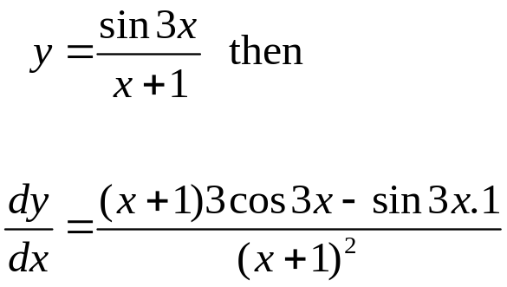
Functions of a function
Quotients
If:
then
For example:

Slide 13
Standard derivatives
Functions of a function
Logarithmic differentiation
Implicit functions
Parametric equations

Slide 14
Standard derivatives
Functions of a function
Logarithmic differentiation
Implicit functions
Parametric equations

Slide 15
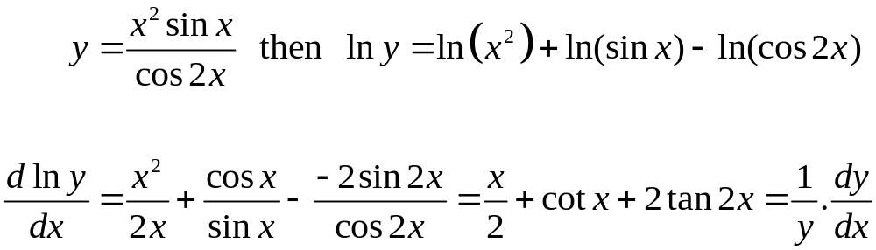
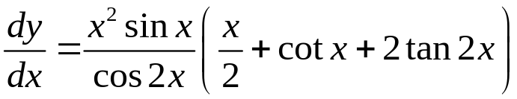
Logarithmic differentiation
Taking logs before differentiating may simplify the working. For example:
Therefore:

Slide 16
Standard derivatives
Functions of a function
Logarithmic differentiation
Implicit functions
Parametric equations

Slide 17
Standard derivatives
Functions of a function
Logarithmic differentiation
Implicit functions
Parametric equations

Slide 18

Implicit functions
There are times when the relationship between x and y is more involved and y cannot be simply found in terms of x. For example:
In this case a relationship of the form y = f (x) is implied in the given equation.

Slide 19

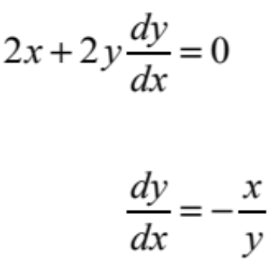
Implicit functions
To differentiate an implicit function remember that y is a function of x. For example, given:
Differentiating throughout gives:
so.

Slide 20
Standard derivatives
Functions of a function
Logarithmic differentiation
Implicit functions
Parametric equations

Slide 21
Standard derivatives
Functions of a function
Logarithmic differentiation
Implicit functions
Parametric equations

Slide 22

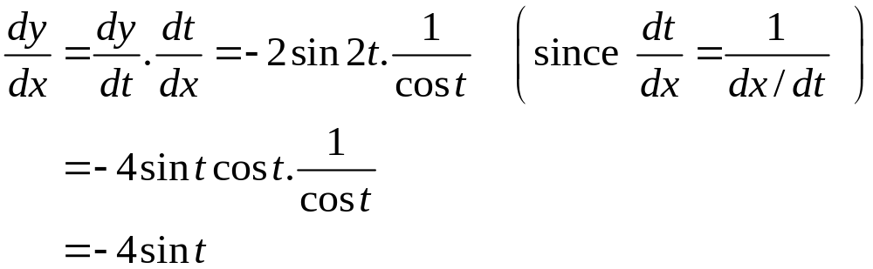
Parametric equations
Sometimes the relationship between x and y is given via a third variable called a parameter. For example, from the two parametric equations
the derivative of y with respect to x is found as follows:

Slide 23
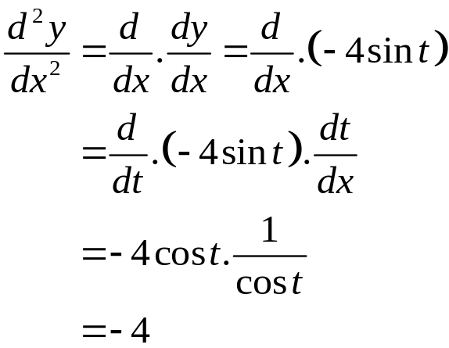
Parametric equations
The second derivative is found as follows:

Slide 24
Learning outcomes
Differentiate by using a list of standard derivatives
Apply the chain rule
Apply the product and quotient rules
Perform logarithmic differentiation
Differentiate implicit functions
Differentiate parametric equations

